Slide 1

EC-204
<LAB- 4>
NITK SURATHKAL
INBASEKARAN.P
201EC226
Prof: Sumam S

Slide 2
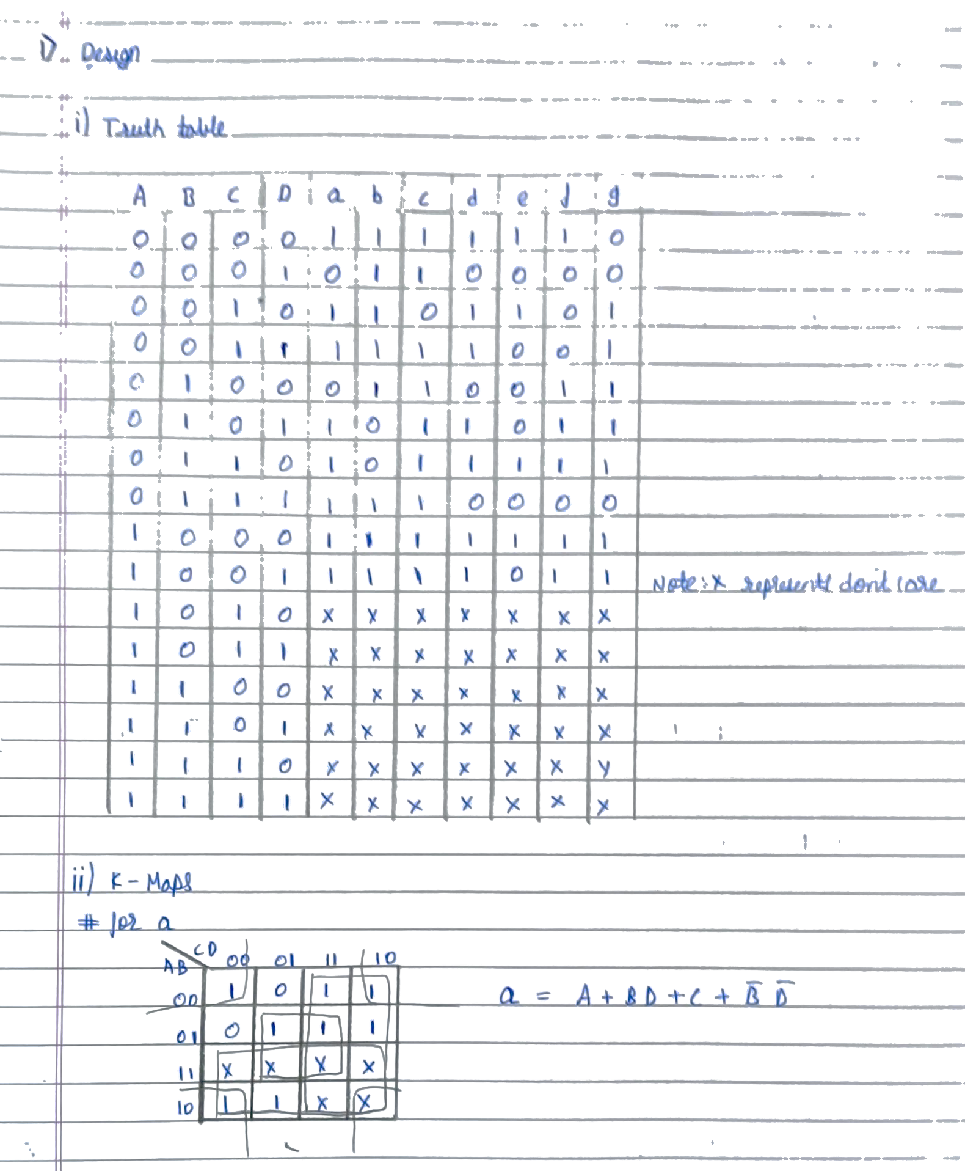
a) BCD to seven segment decoder. Use the seven segment display in logisim for output. The pin details can be found in Help - Library Reference

Slide 3
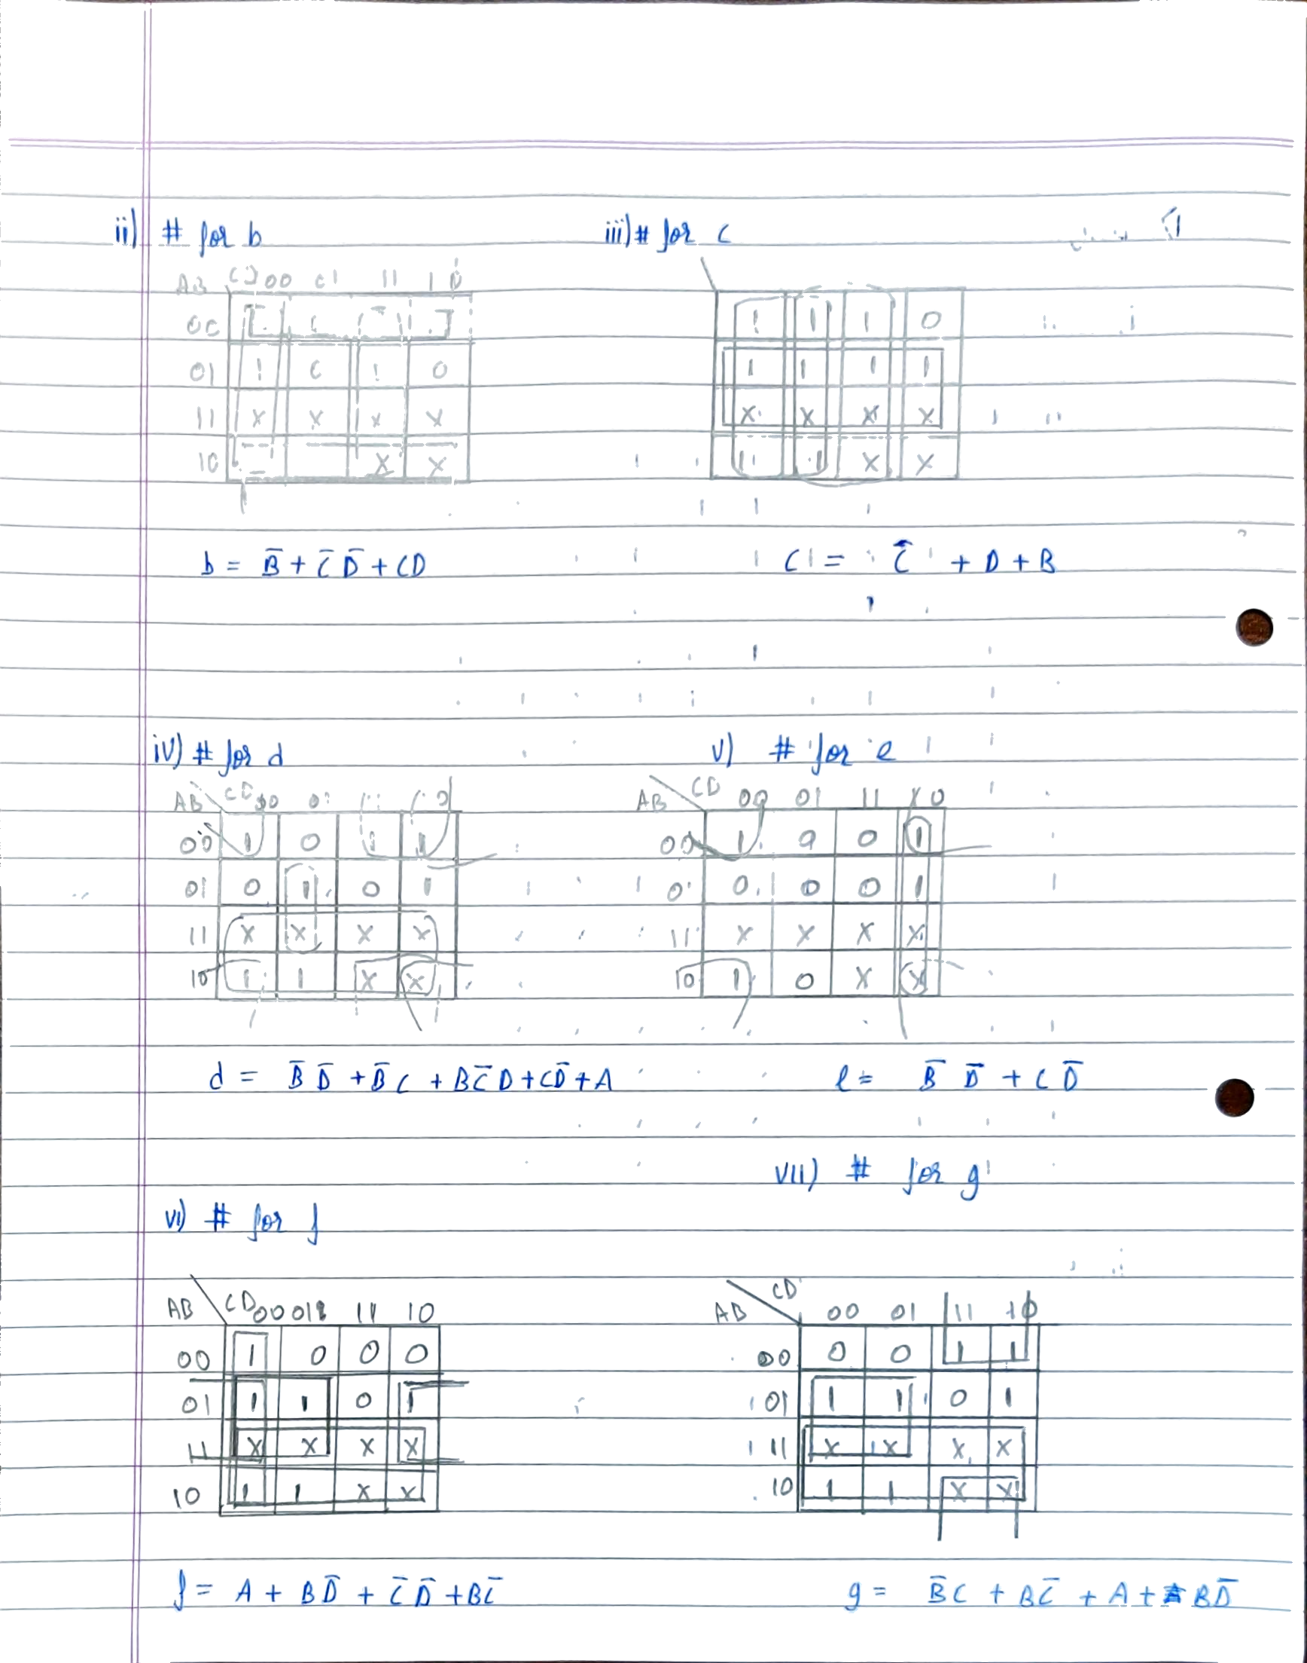

Slide 4
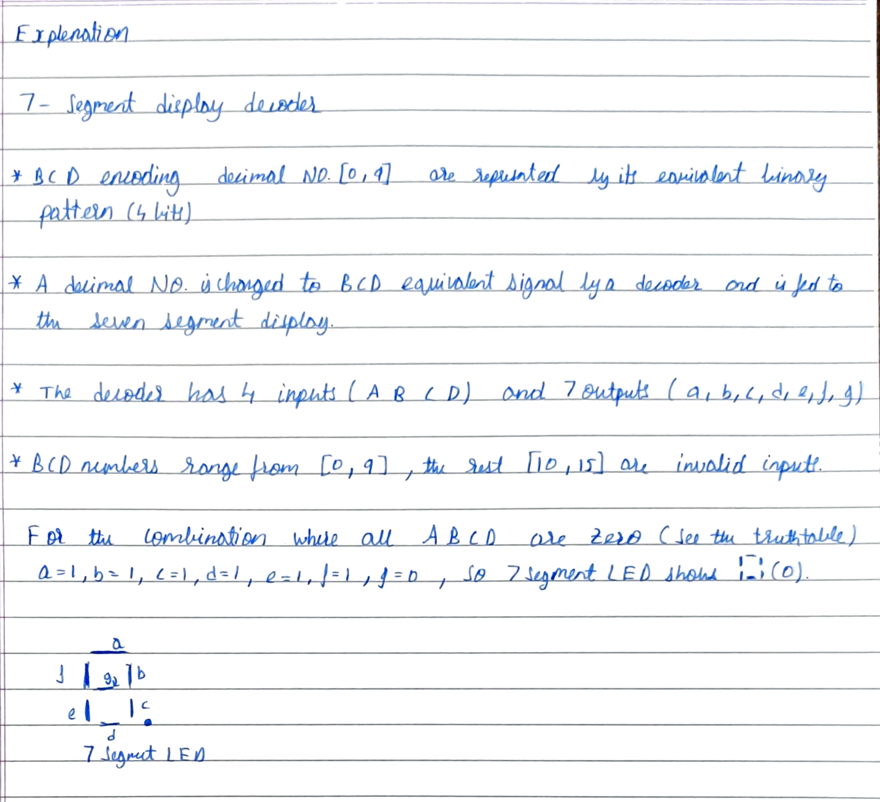
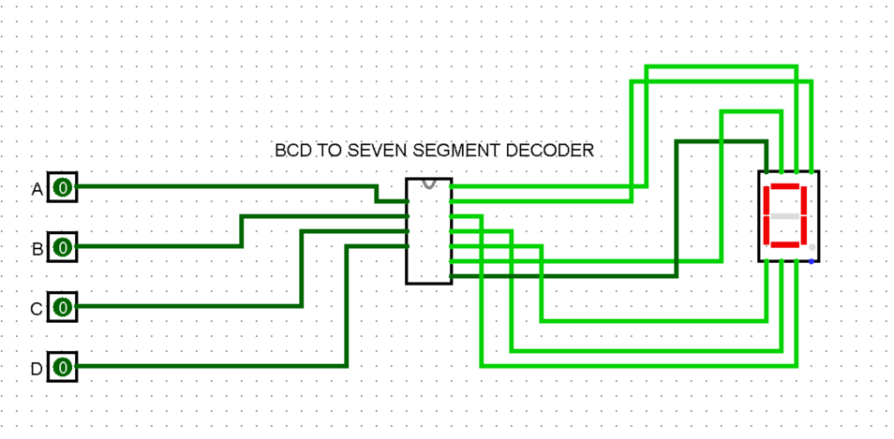
Circuit diagram from logisim

Slide 5
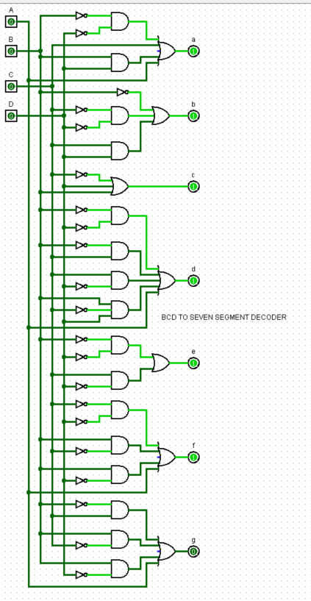
Circuit diagram from logisim

Slide 6
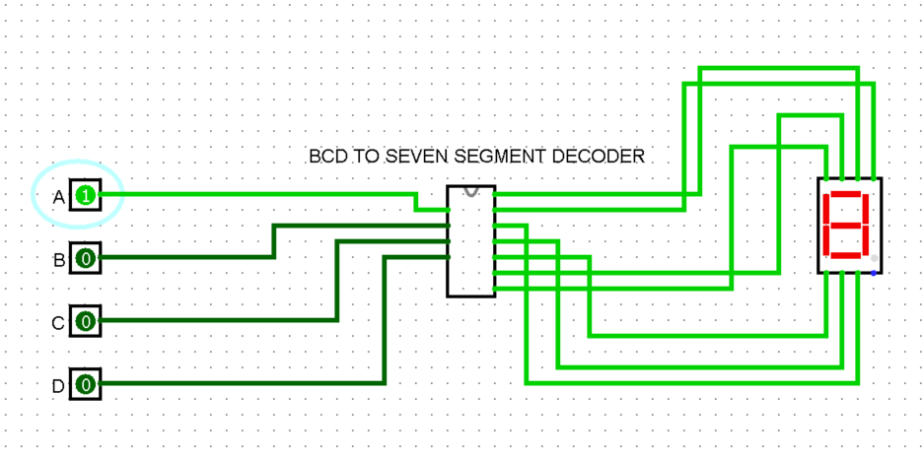
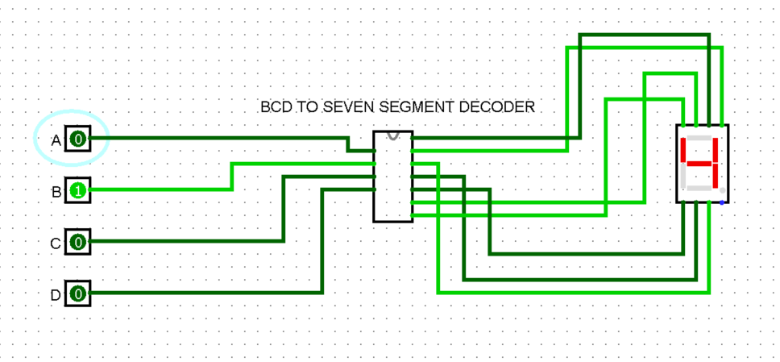
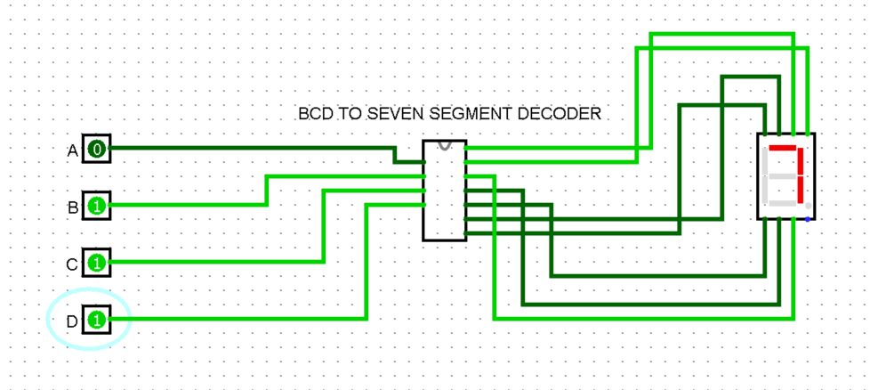
Results obtained – Test input and outputs
Input: A = 1, B = 0, C = 0, D = 0 and Output: 8
Input: A = 0, B = 1, C = 0, D = 0 and Output: 4
Input: A = 0, B = 1, C = 1, D = 1 and Output: 7

Slide 7
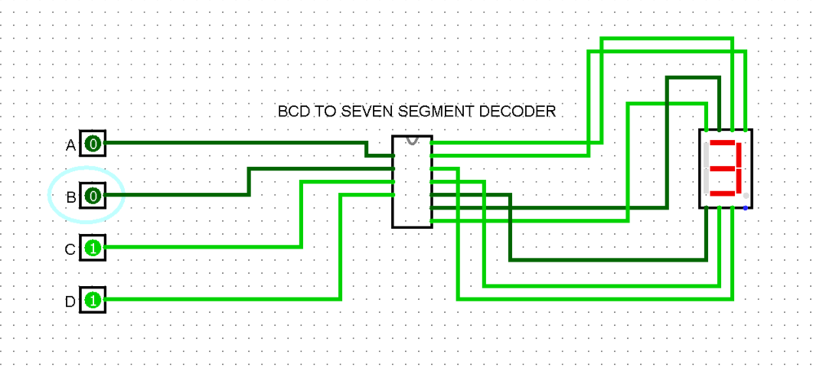
Results obtained – Test input and outputs
Input: A = 0, B = 0, C = 1, D = 1 and Output: 3

Slide 8
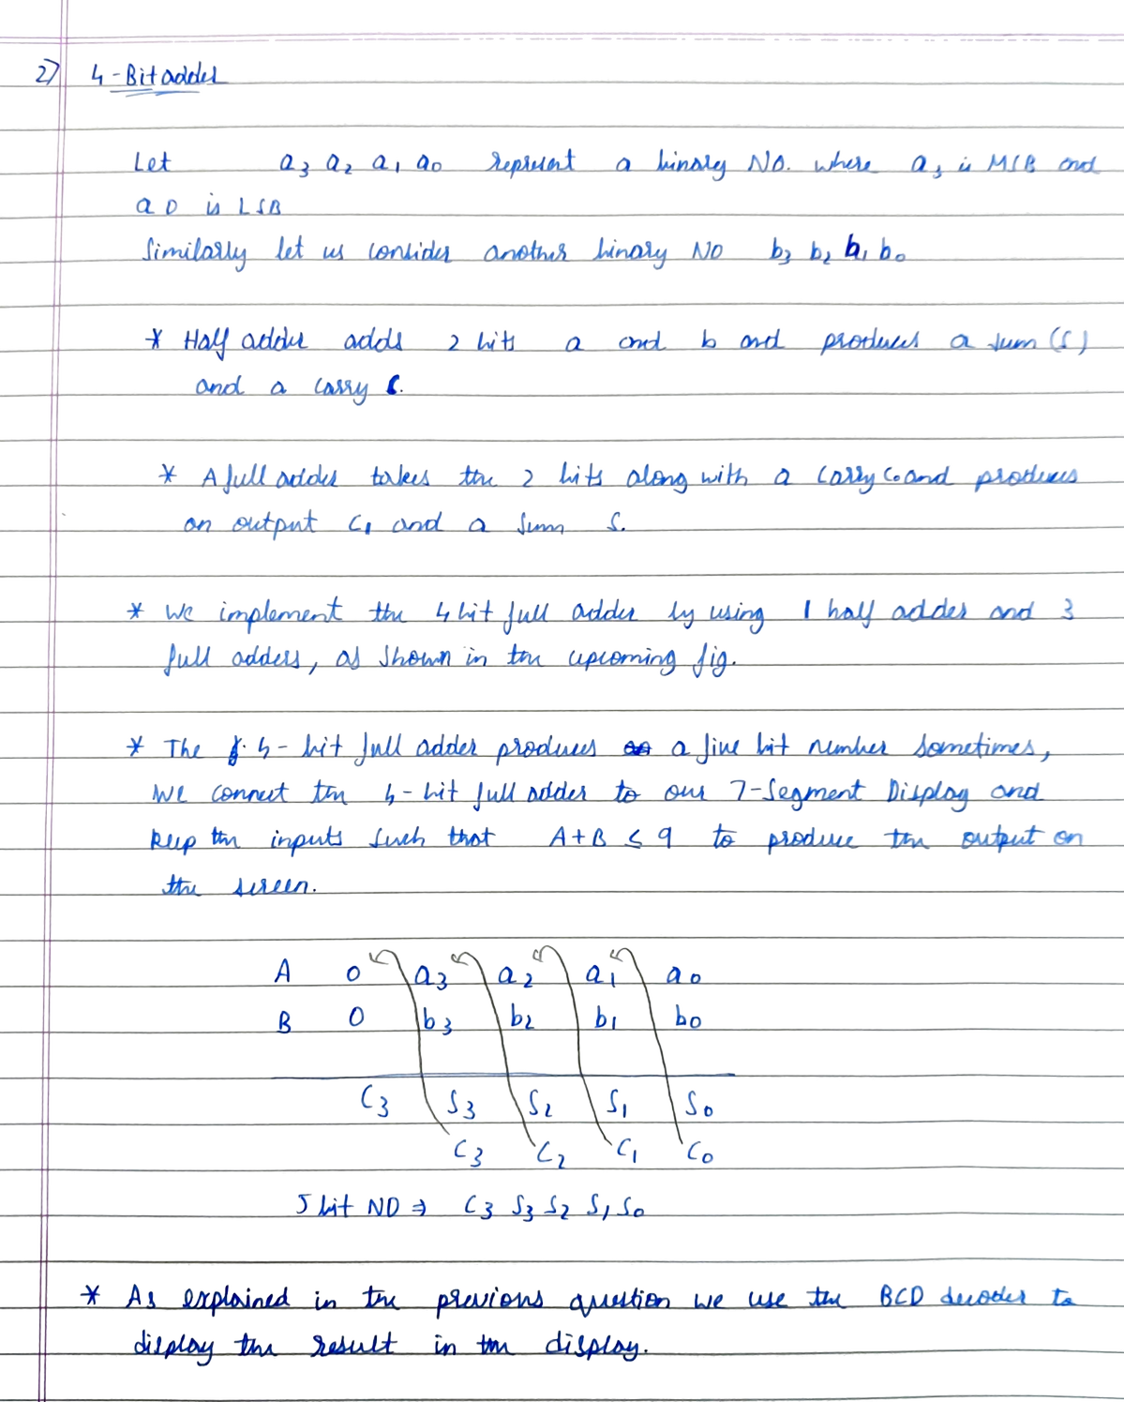
b) Connect the BCD to seven segment decoder to the output of the 4 bit adder implemented in last class. Test for inputs such that A+B <= 9

Slide 9
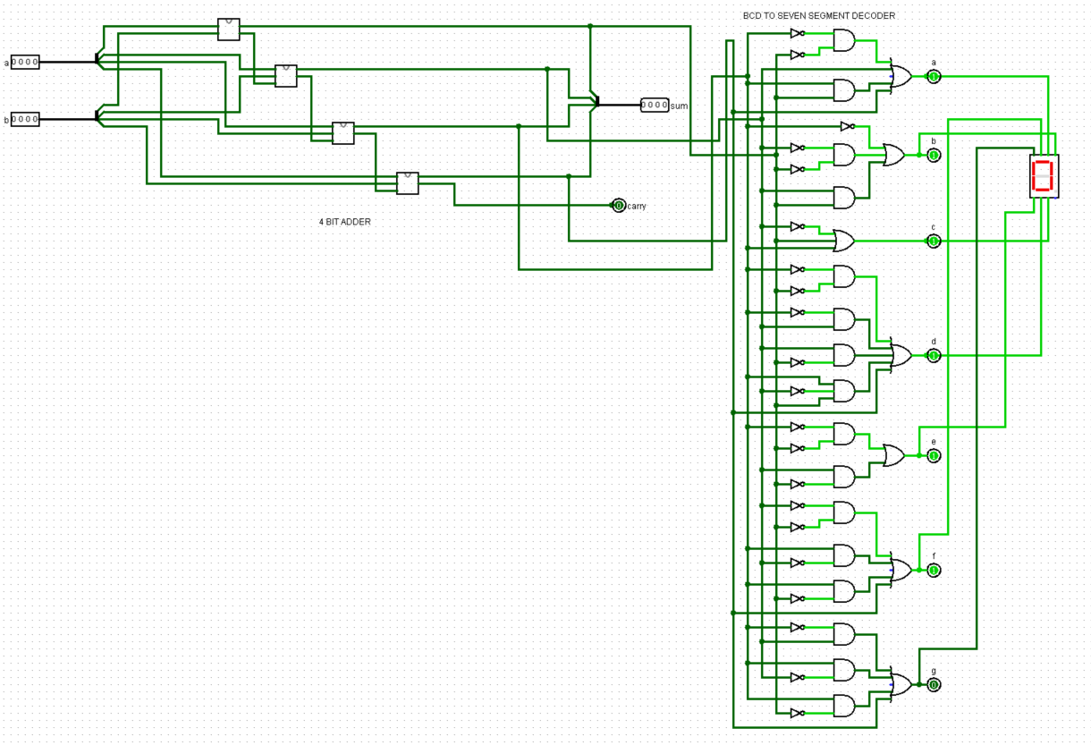
Circuit diagram from logisim

Slide 10
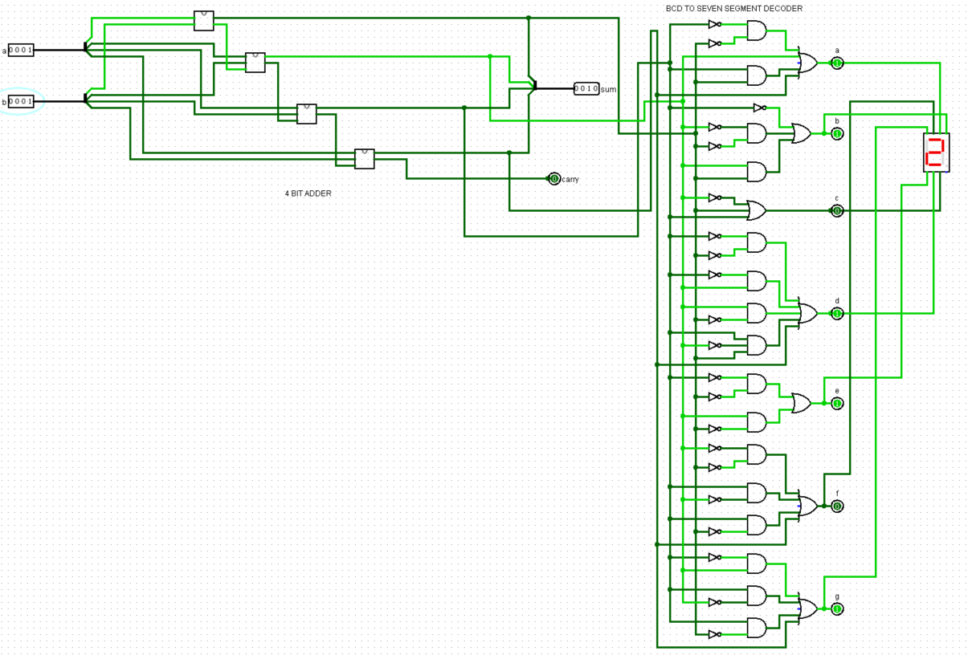
Results obtained – Test input and outputs
Input: A = 1, B = 1 and Output: 2

Slide 11
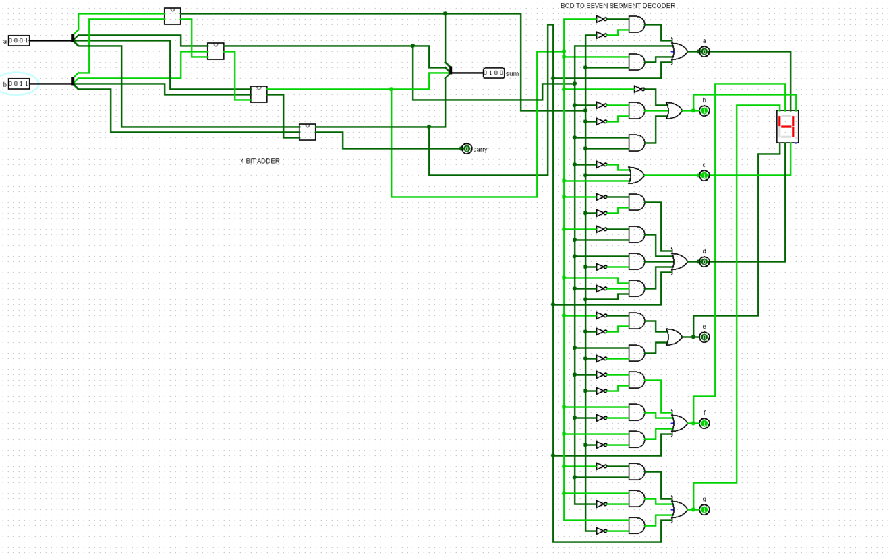
Results obtained – Test input and outputs
Input: A = 1, B = 3 and Output: 4

Slide 12
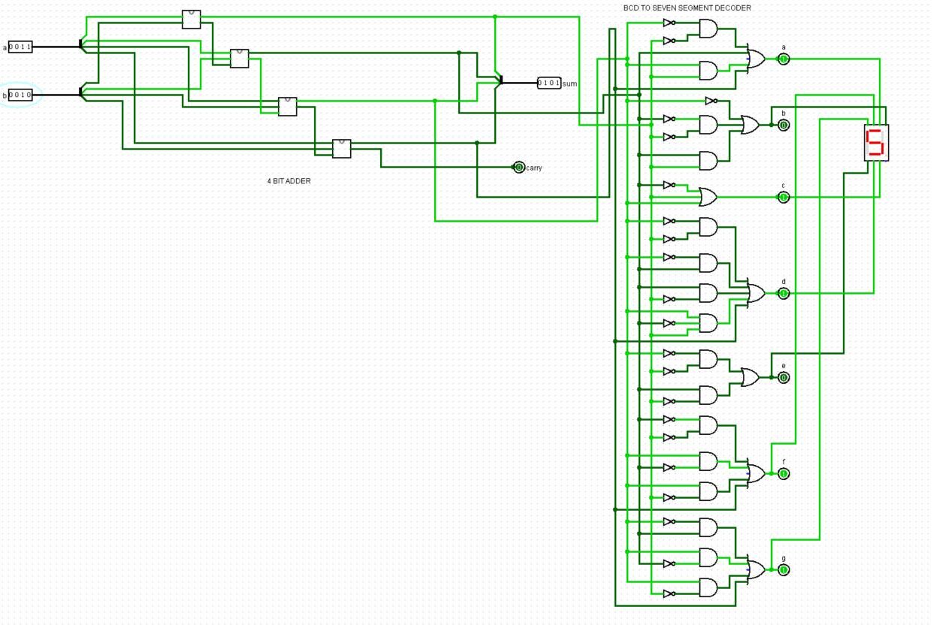
Results obtained – Test input and outputs
Input: A = 3, B = 2 and Output: 5

Slide 13
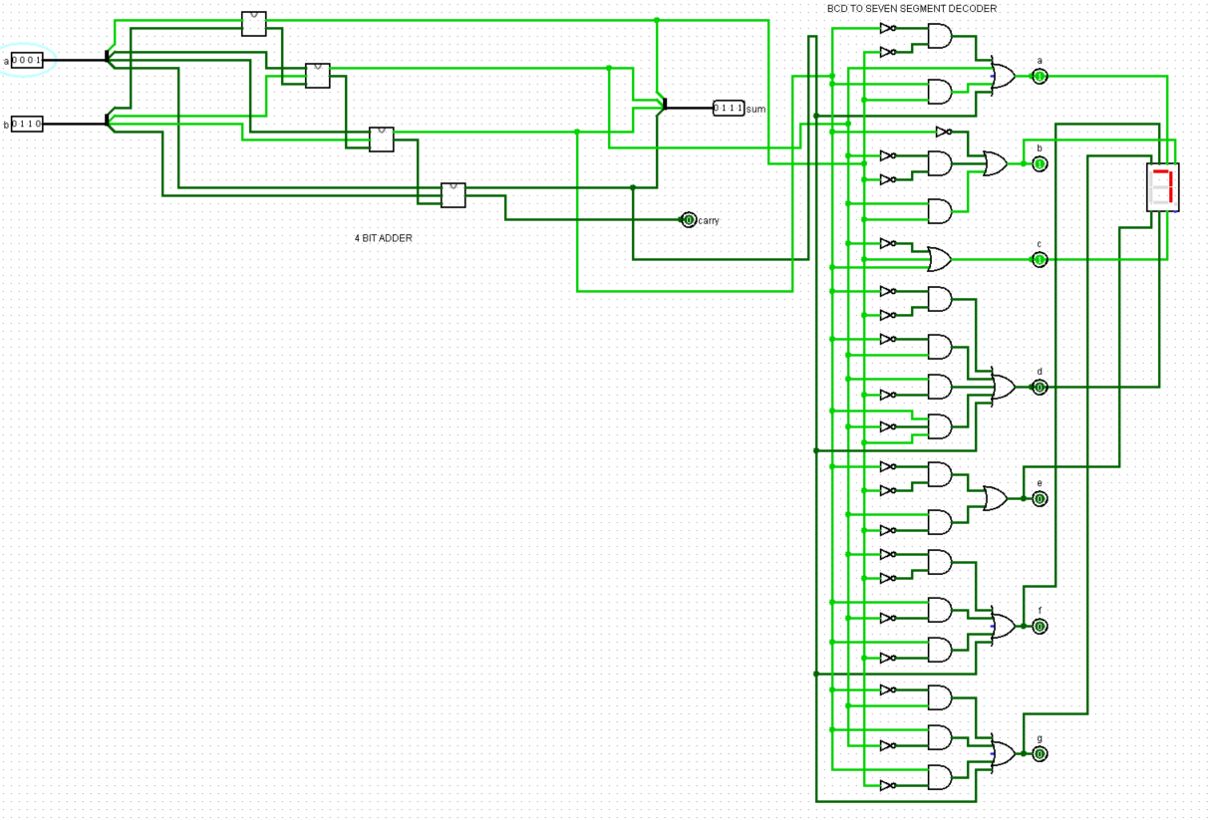
Results obtained – Test input and outputs
Input: A = 1, B = 6 and Output: 7

Slide 14
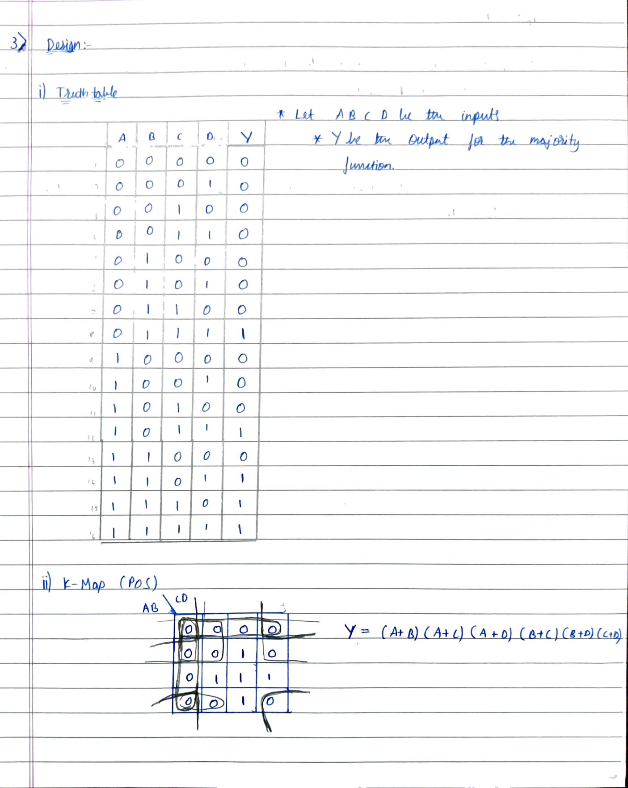
c) A four variable logic function that is equal to 1 if any three or all four of its variables are equal to 1 is called a majority function. Design a minimum cost POS circuit using NOR gates that implements this majority function

Slide 15
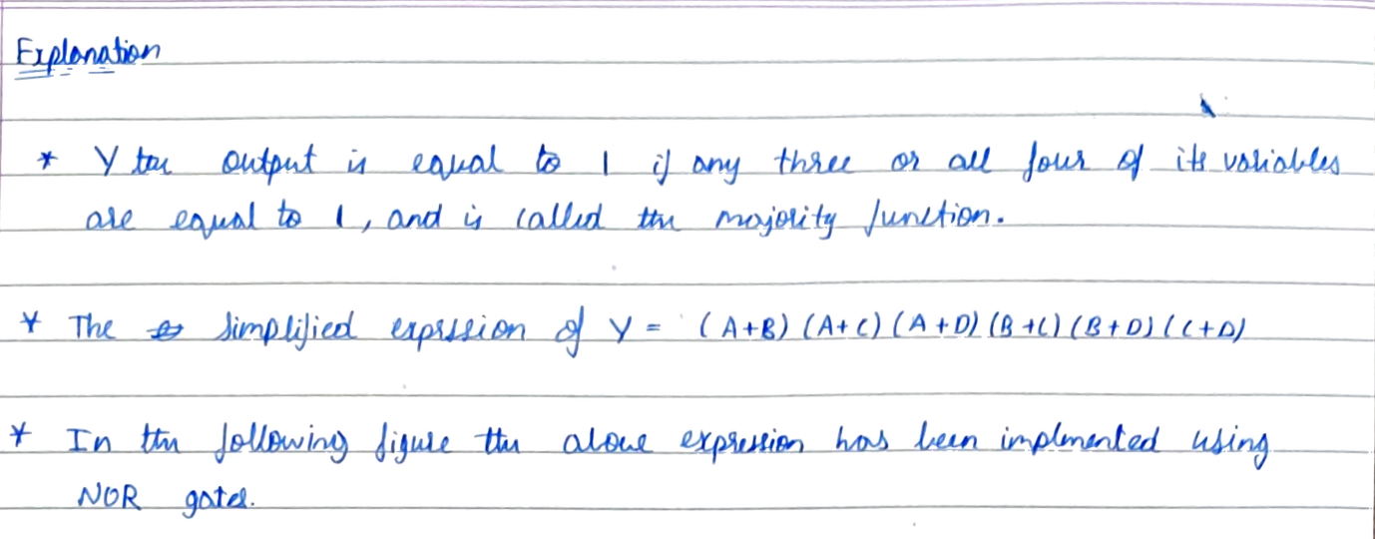
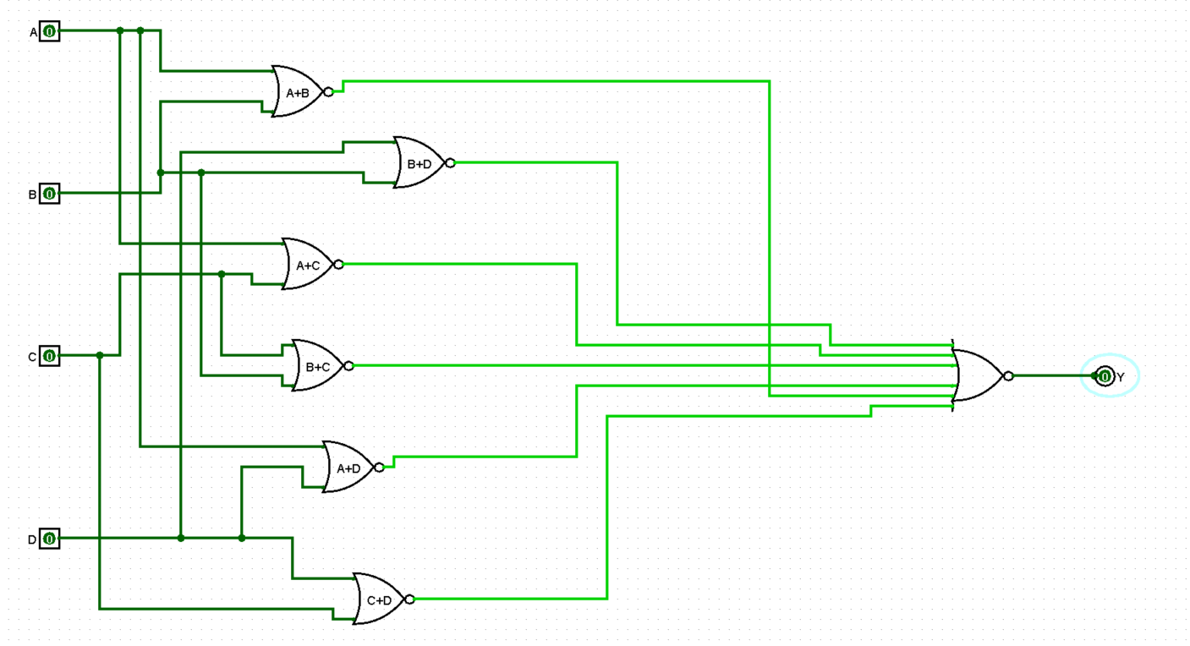
Circuit diagram from logisim

Slide 16
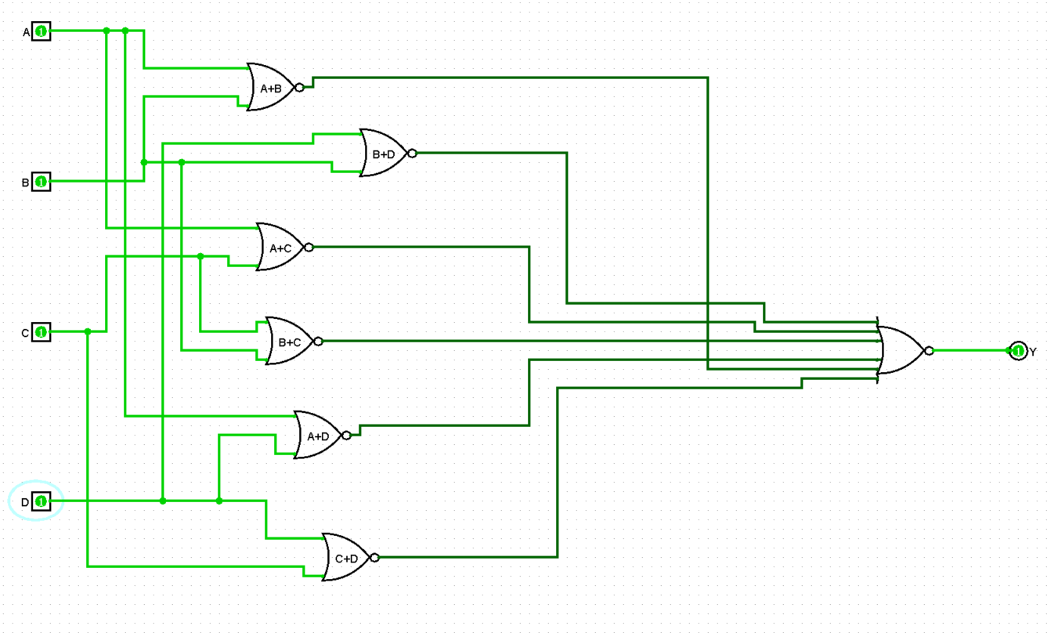
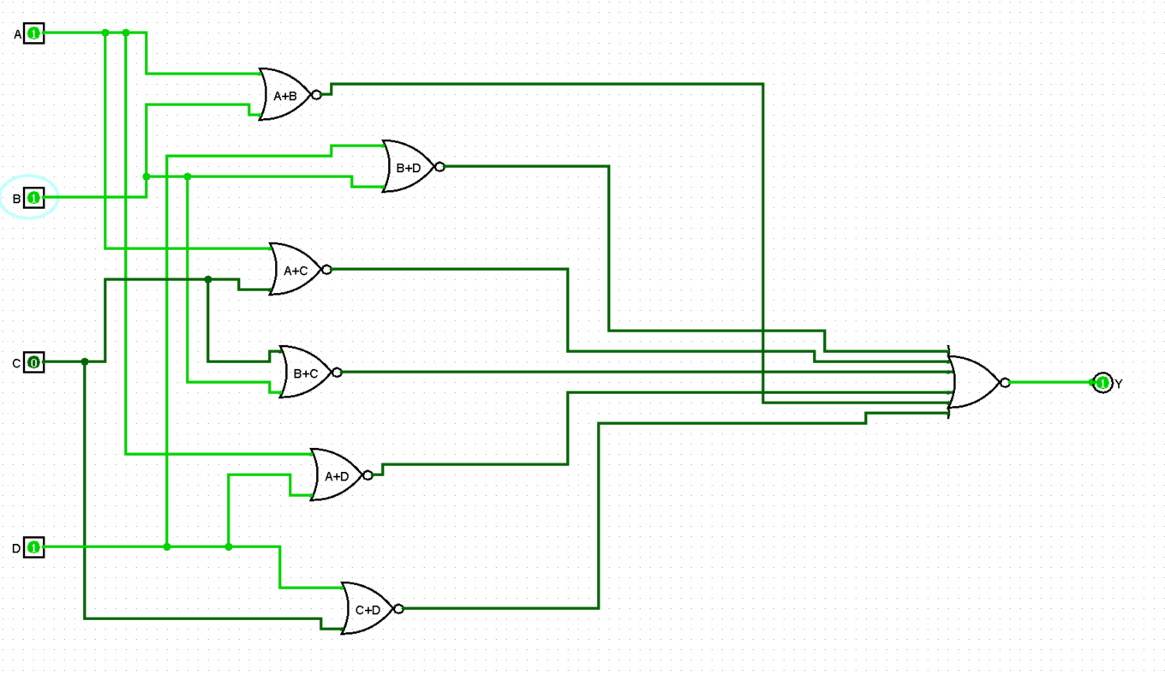
Results obtained – Test input and outputs
Input: A = 1, B = 1, C = 1, D = 1 and Output: Y = 1
Input: A = 1, B = 1, C = 0, D = 1 and Output: Y = 1

Slide 17
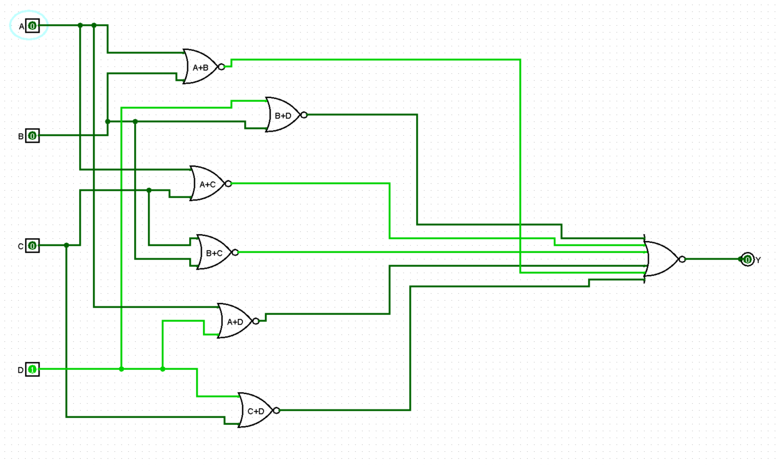
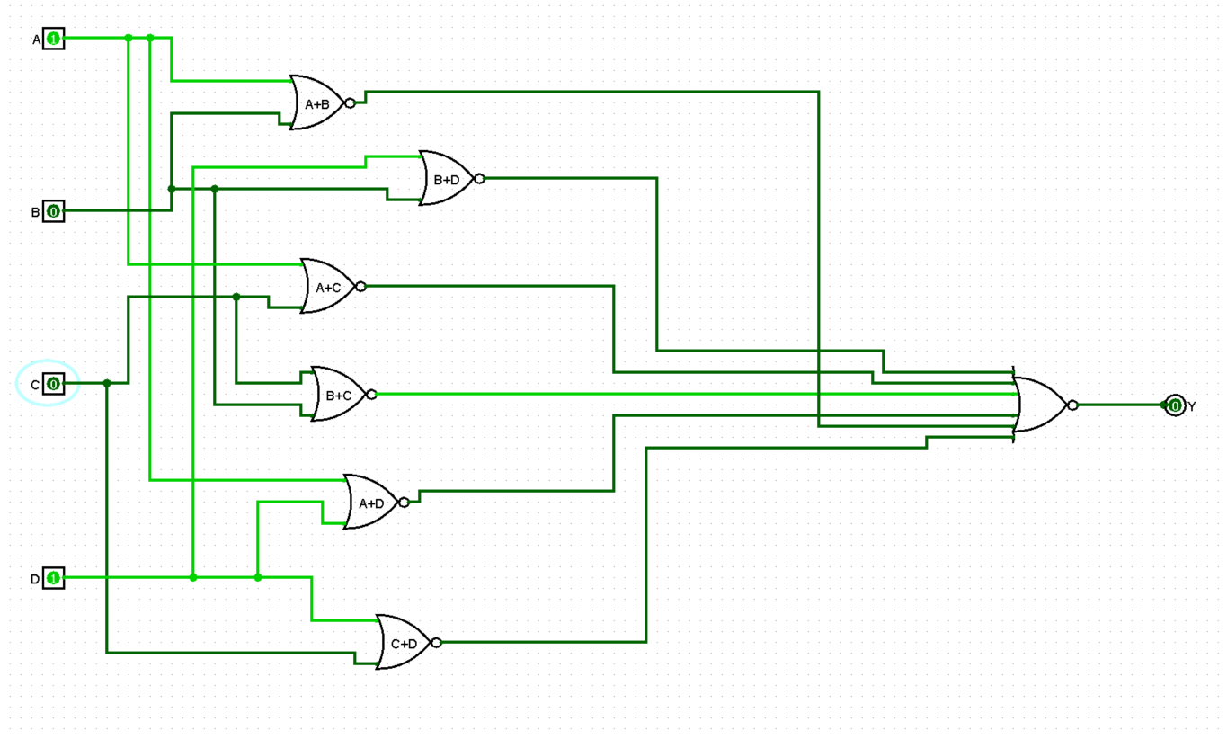
Results obtained – Test input and outputs
Input: A = 0, B = 0, C = 0, D = 1 and Output: Y = 0
Input: A = 1, B = 0, C = 0, D = 1 and Output: Y = 0

Slide 18
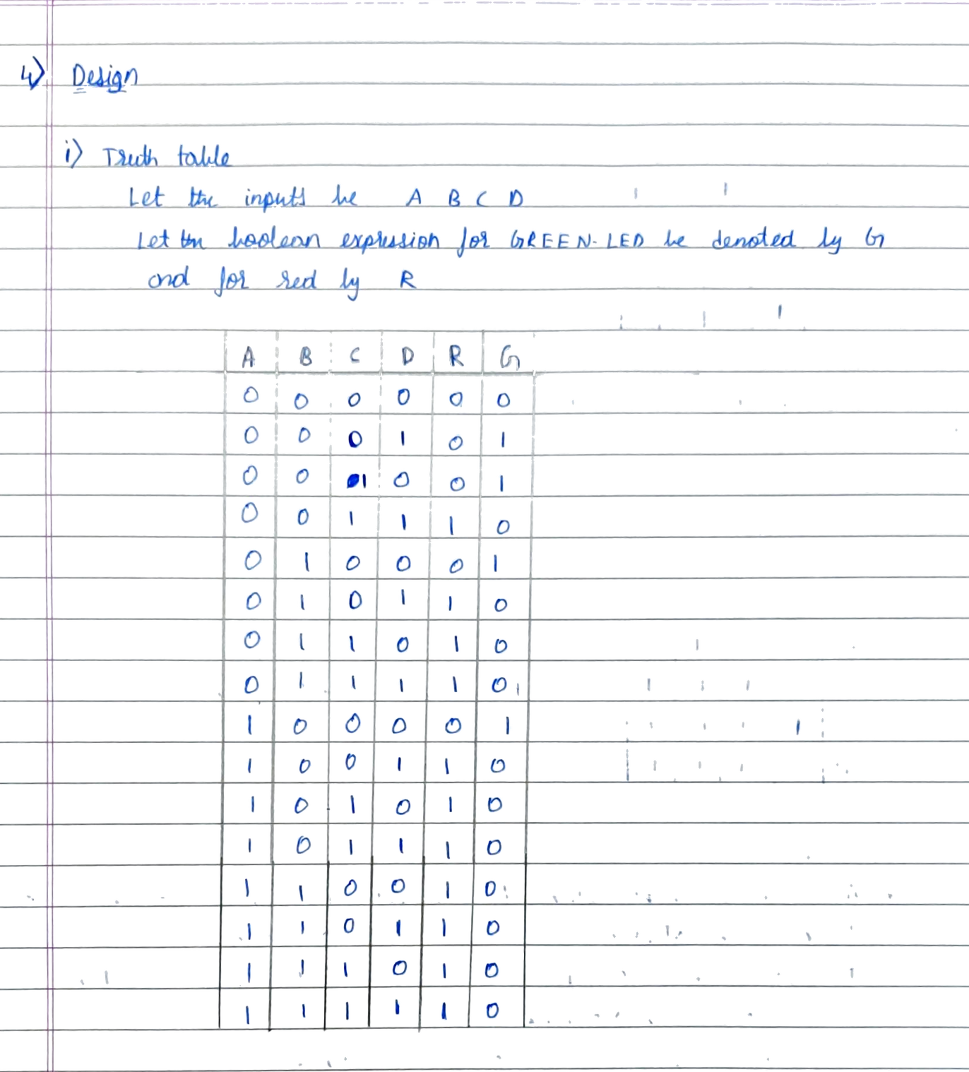
d) A given system has four sensors that produce an output of 0 or 1. The system operates properly when exactly one of the sensors has its output equal to 1. An alarm must be raised when two or more sensors have the output of 1. Design the simplest circuit that can be used to raise the alarm. Use a red LED to indicate ALARM and a green LED to indicate the system operated properly.

Slide 19
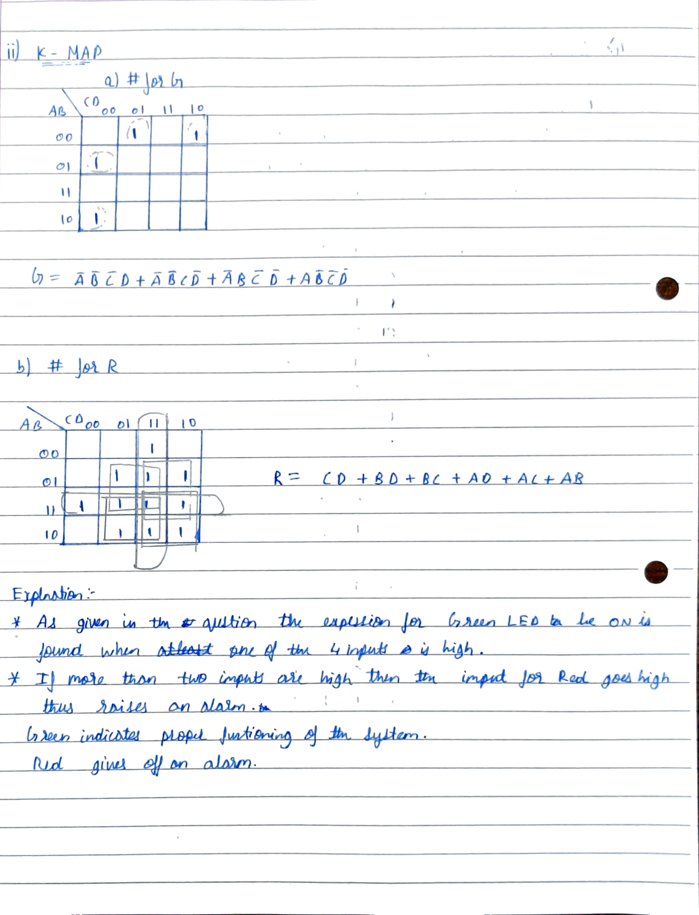

Slide 20
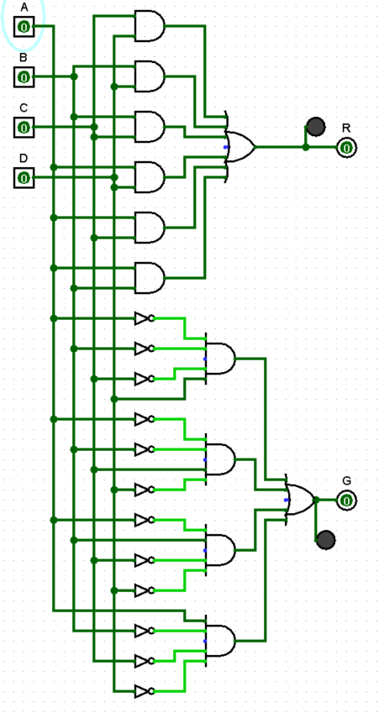
Circuit diagram from logisim

Slide 21
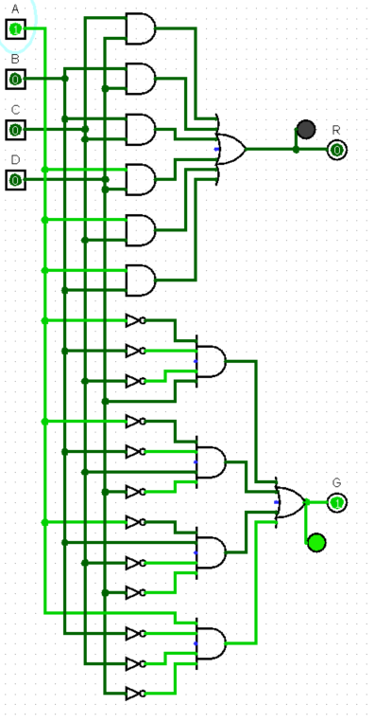
Results obtained – Test input and outputs
Input: A = 1, B = 0, C = 0, D = 0 and Output: R = 0, G = 1

Slide 22
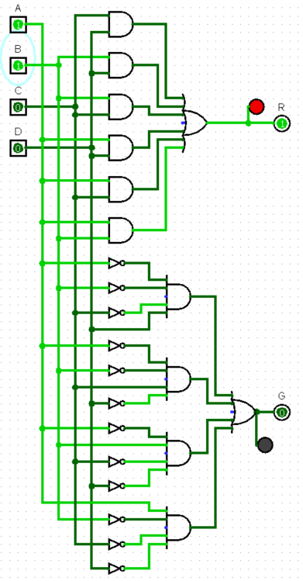
Results obtained – Test input and outputs
Input: A = 1, B = 1, C = 0, D = 0 and Output: R = 1, G = 0

Slide 23
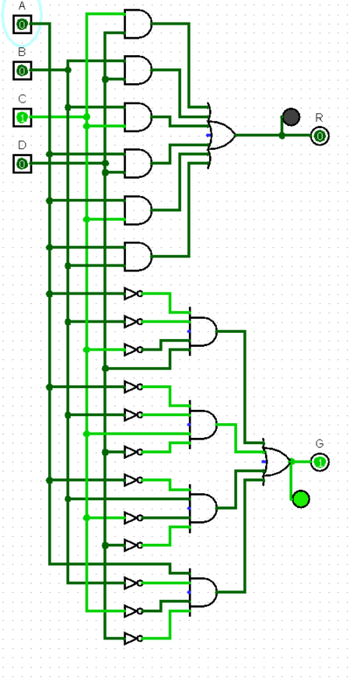
Results obtained – Test input and outputs
Input: A = 0, B = 0, C = 1, D = 0 and Output: R = 0, G = 1

Slide 24
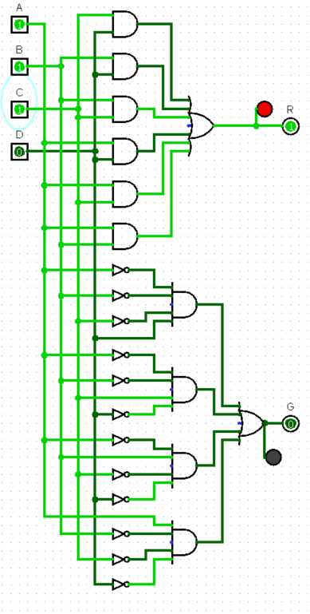
Results obtained – Test input and outputs
Input: A = 1, B = 1, C = 1, D = 0 and Output: R = 1, G = 0

